Slide 1
Graph Algorithms
BFS, DFS, Transitive closure, Topological Sort, Connected Components

Slide 2
Transitive closure
https://www.youtube.com/watch?v=Hu4pEt-TGJo (watch from 7:40 mins)
(discussed example on board)
Related problem statements
find indirect relations in given topology or communication network/ find multi hop connections in LAN network etc.

Slide 3
Which graph representation to use?
|E| < |V| log |V| sparse graph : Adjacency matrix
(symmetric, upper triangular)
Adjacency List : not when too many deletions; may use doubly linked list
Disjoint Set : Union and Find operations (fast search)

Slide 4
Write functions to find
Max. edges in undirected graph ^{V}C₂ = V(V-1)/2
Max. edges in directed acyclic graph V²
No. of adjacency matrices ^{V}P_{V} = V!
No. of adjacency lists ^{E}P_{E} = E!
Max. no. of cut vertices V-2 (all except first and last)

Slide 5
Graph Traversals
Breadth First Search : BFS uses QUEUE: FIFO
Depth First Search : DFS uses STACK : LIFO
Both O(V+E) time complexity
HINT: use DFS when space constraints are there because it does not store child pointers at each level

Slide 6
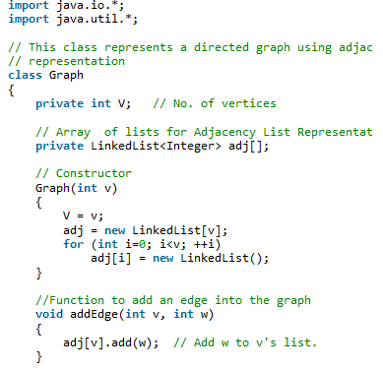
DFS

Slide 7
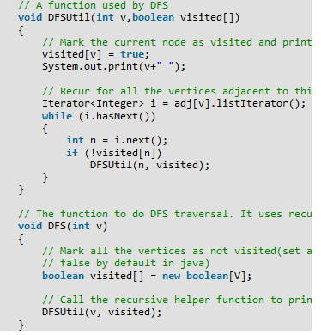
DFS

Slide 8
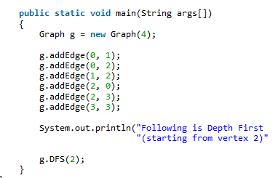

DFS
2

Slide 9
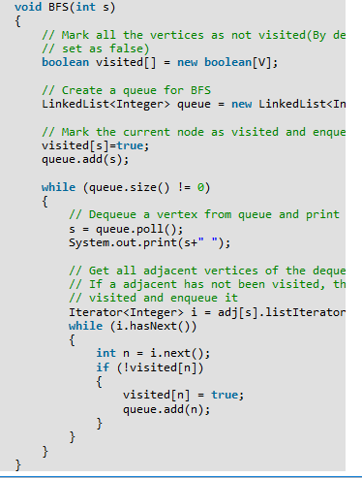

BFS
Starting from vertex 2

Slide 10
DFS application: Cut vertex or articulation points
Remove such vertex, graph splits into two disconnected components
Find all cut vertices in O(n) time
Similarly, cut edges or bridges
We need:
No. of nodes visited by each node,
Lowest depth (top) of visited nodes
node with lowest count of visited nodes

Slide 11
DFS application: Detecting cycles
Back edge → cycle
No back edges → acyclic

Slide 12
Directed Acyclic Graph (DAG)
SAMPLE PROBLEMS
Deadlock
Pipelining
Course prerequisites

Slide 13
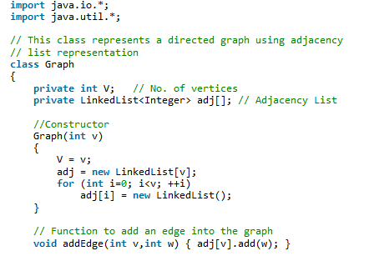
DAG

Slide 14
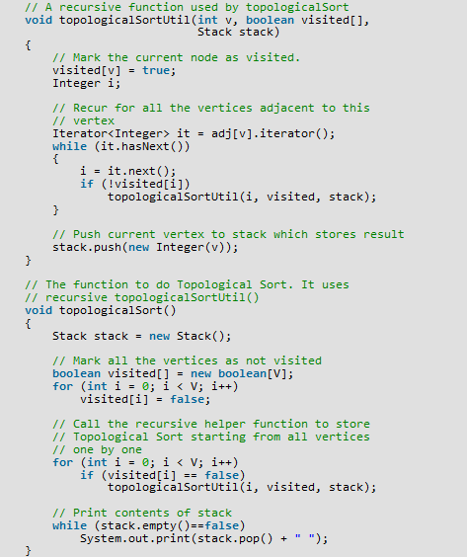
DAG in Java

Slide 15
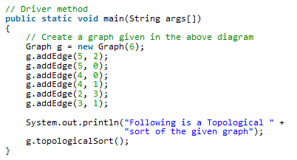

DAG

Slide 16
DFS application: Finding Depth of DAG
For depth of tree (acyclic graph where vertex can not have more than one parent), we used in-order traversal (LNR) with one extra symbol to indicate end of the level
Similarly, for DAG

Slide 17
DFS application: DAG
Consider the course prerequisites, all prerequisites must be obeyed
Every course is offered every semester
There is no limit to number of courses we can take in one semester
minimum number of semesters required to complete the major?
Describe the data structure we would use to represent this problem
Outline a linear time algorithm for solving it
Use a DAG because the prerequisite relation has no cycles
vertices represent courses and the edge represent the prerequisite relation

Slide 18
Graphs: Check isomorphism
iff for some ordering of their vertices, adjacency matrices are equal
Matrix transformation operations are needed

Slide 19
Digraph reversal or transpose
Reverse bits in adjacency matrix

Slide 20
Check bipartite-ness
iff no odd length cycle
Job seekers vs. Skill etc.

Slide 21
Matching problem: Hungarian Algorithm
Matching : no two edges have any common vertices
Marriage problem
Personnel problem

Slide 22
DFS application: strongly connected components
Equivalence relation
Reflexive
Symmetric
Transitive

Slide 23
DFS application: Euler circuits
Cover all edges exactly once; start vertex = end vertex
iff
connected graph with all vertices of even degree OR
exactly 2 vertices of odd degree
Hamiltonian ckt. : cover all vertices exactly once;
start vertex = end vertex;
no η algo known

Slide 24
Sample problems on Euler circuits
Construct graph without lifting your pen or redrawing a line
Find path for a postman covering all streets, ending at the start point and not revisiting any street

Slide 25
Sample problems on Hamiltonian path
Unique topological ordering: iff directed edge between pair of consecutive vertices, i.e., all vertices covered exactly once, i.e., Hamiltonian path
>1 topological ordering can be obtained by swapping adjacent vertices

